Slide 1
We will start the webinar shortly. Thanks for joining in.
GRANDPARENT ALIENATION: HOW DO WE ADDRESS IT?

Slide 2
GENE C. COLMAN FAMILY LAW CENTRE 6TH IN A SERIES OF PUBLIC WEBINARS
GRANDPARENT ALIENATION: HOW DO WE ADDRESS IT?
July 16, 2020
Gene C. Colman, B.A., LL.B.

Slide 3
In support of the North York Harvest Food Bank
GRANDPARENT ALIENATION: HOW DO WE ADDRESS IT?
July 16, 2020
Gene C. Colman, B.A., LL.B.

Slide 4
INTRODUCTION
North York Harvest Food Bank
https://northyorkharvest.com/gene-c-colman/

Slide 5
GRANDPARENT ALIENATION INTRODUCTION
Our Partners
Alienated Grandparents Anonymous
Brayden Supervision Services
Canadian Association for Equality (CAFE)
Canadian Equal Parenting Council
Cangrands National Kinship Support
Equal Parenting for Children
Grandparents Without Access Hamilton
Lawyers for Shared Parenting
Real Women of Canada
Side by Side Supervised Access Services

Slide 6
GRANDPARENT ALIENATION INTRODUCTION
Our Team
https://www.complexfamilylaw.com/Our-Team/
Gene C. Colman
Gloria Antwi
Jenny Kirshen
Robert McNeillie
Kulbir K. Rahal Vaid
Law Clerk: Kim Pitre

Slide 7
GRANDPARENT ALIENATION INTRODUCTION
WITH SPECIAL
GUEST PANELIST
“AMANDA”
Founder and Director of Alienated Grandparents Anonymous

Slide 8
GRANDPARENT ALIENATION INTRODUCTION
How to present questions:
You can send your questions to Rob McNeillie in the Q & A section of the ZOOM platform.
You can email Rob: robert@complexfamilylaw.com

Slide 9
GRANDPARENT ALIENATION PART 1: INTRODUCTION
OUTLINE OF TOPICS TO BE COVERED
TWO TYPES, THREE APPROACHES
THE STATUTORY FRAMEWORK
WHAT DO THE CASES TELL US?
COLMAN’S RANT AGAINST THE LAW AS IT EXISTS
COLMAN’S SUGGESTED GUIDING PRINCIPLES
SOCIAL SCIENCE LITERATURE
NON-JUDICIAL REMEDIES
SOME PARTING THOUGHTS, A STORY AND A SUMMING UP
SO WHAT HAVE WE LEARNED? LET’S SUM UP.
COMMENTS AND QUESTIONS

Slide 10
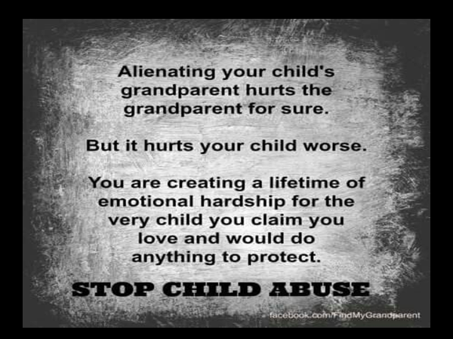
GRANDPARENT ALIENATION PART 1: INTRODUCTION

Slide 12
GRANDPARENT ALIENATION PART 2:TWO TYPES, THREE APPROACHES
TWO TYPES OF ALIENATED GRANDPARENTS
Type #1: Grandparent…parent…grandchild
Type #2: collateral damage

Slide 13
GRANDPARENT ALIENATION PART 2:TWO TYPES, THREE APPROACHES

Slide 14
GRANDPARENT ALIENATION PART 2:TWO TYPES, THREE APPROACHES
Colman is firmly opposed to grandparent alienation.

Slide 15
GRANDPARENT ALIENATION PART 2:TWO TYPES, THREE APPROACHES
THREE APPROACHES
1. PARENTAL AUTONOMY
PRO-CONTACT
HYBRID

Slide 16
GRANDPARENT ALIENATION PART 2:TWO TYPES, THREE APPROACHES
Approach #1: Parental Autonomy
Fit parent
Best interest
No court intervention
Nova Scotia Law Commission, 2007
D. v. C. (2017)

Slide 17
GRANDPARENT ALIENATION PART 2:TWO TYPES, THREE APPROACHES
Approach #2: Pro Contact
Best interest

Slide 18
GRANDPARENT ALIENATION PART 2:TWO TYPES, THREE APPROACHES

Slide 19
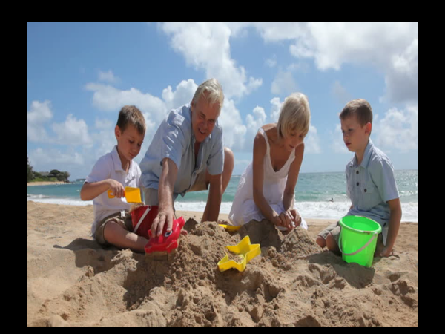
GRANDPARENT ALIENATION PART 2:TWO TYPES, THREE APPROACHES

Slide 20
GRANDPARENT ALIENATION PART 2:TWO TYPES, THREE APPROACHES

Slide 21
GRANDPARENT ALIENATION PART 2:TWO TYPES, THREE APPROACHES

Slide 22
GRANDPARENT ALIENATION PART 2:TWO TYPES, THREE APPROACHES
Approach #3: Hybrid
McLaughlin v Huehn, 2004

Slide 23
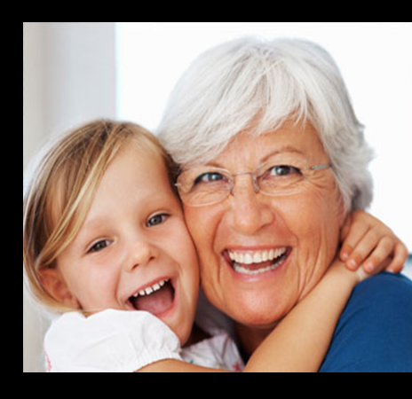
GRANDPARENT ALIENATION PART 2:TWO TYPES, THREE APPROACHES

Slide 24
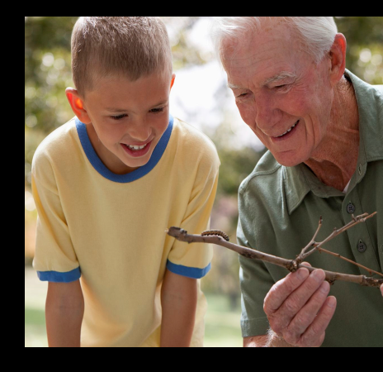
GRANDPARENT ALIENATION PART 2:TWO TYPES, THREE APPROACHES

Slide 25
GRANDPARENT ALIENATION PART 3: THE STATUTORY FRAMEWORK
Children’s Law Reform Act (Ont.)
Federal Divorce Act
Child, Youth and Family Services Act. (Ont.)
Bill C-78

Slide 26
GRANDPARENT ALIENATION PART 4: WHAT DO THE CASES TELL US?
Chapman v. Chapman, 2001 (Ont. C.A.)
due regard being paid the Parental Autonomy philosophy in the law.
where the parents act arbitrarily in the face of loving and nurturing relationships, then “the court may intervene to protect the continuation of the benefit of the family relationship.”

Slide 27
GRANDPARENT ALIENATION PART 4: WHAT DO THE CASES TELL US?
Giansante v. Di Chiara, 2005 (Ont. S.C.J.)
1. Does a positive grandparent-grandchild relationship already exist?
2. Has the parent’s decision imperilled the positive grandparent-grandchild relationship? and,
3. Has the parent acted arbitrarily?

Slide 28
GRANDPARENT ALIENATION PART 4: WHAT DO THE CASES TELL US?
Capone v. Pirri, 2018 (Ont. S.C.J.)
“time and depth”
“something more than an occasional pleasant experience with the children”
a close bond with strong emotional ties deserving of preservation in order to displace the principle of parental autonomy.
Justice Jarvis raised the bar.

Slide 29
GRANDPARENT ALIENATION PART 4: WHAT DO THE CASES TELL US?
Torabi v. Patterson, 2016 ONCJ 210
substantial pre-existing relationship, with strong, loving, and nurturing ties;
constructive for the child in the sense that it is worth preserving. If relations are too poisoned, …
age of the child and the time since the child last saw the relative;
exceptional circumstance of a young child who has lost a parent.

Slide 30
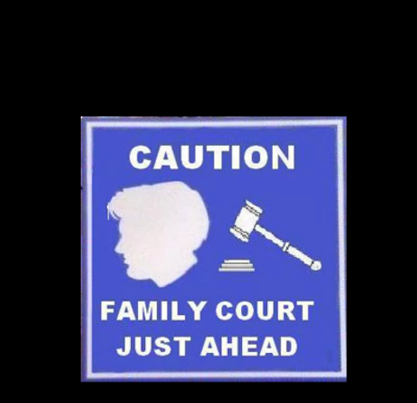
GRANDPARENT ALIENATION PART 5: COLMAN’S RANT AGAINST THE LAW AS IT EXISTS

Slide 31
GRANDPARENT ALIENATION PART 5: COLMAN’S RANT AGAINST THE LAW AS IT EXISTS
The child protection system
The child custody/access parenting system
no valid policy reason to emphasize parental autonomy
prioritize the child’s best interests in this area of the law just as we prioritize the child’s best interests in every single other area of family law.

Slide 32
GRANDPARENT ALIENATION PART 5:
Anxiety and Stress - I strongly disagree!
Destabilize the family unit
Just focus on your relationship with your grandchild.
Siblings
Notes:
Ninkovic v. Utjesinovic, 2019 ONSC 558 (Ont. S.C.J.) – This case has a very good summary of the current law.

Slide 33
GRANDPARENT ALIENATION PART 6: COLMAN’S SUGGESTED GUIDING PRINCIPLES
Section A: Basic principles…maximize your chances!
PRE-EXISTING RELATIONSHIP: Demonstrate that you have had a pre-existing loving relationship with your grandchildren.
AVOID CONFLICT: Avoid conflict with your own children where at all possible. Be a peacemaker and not a troublemaker.

Slide 34
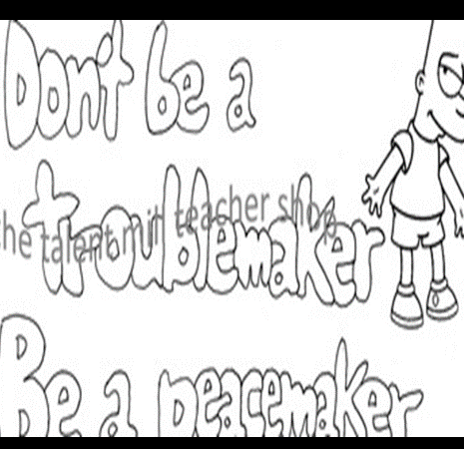
GRANDPARENT ALIENATION PART 6: COLMAN’S SUGGESTED GUIDING PRINCIPLES
Section A: Basic principles…maximize your chances!

Slide 35
GRANDPARENT ALIENATION PART 6: COLMAN’S SUGGESTED GUIDING PRINCIPLES
Section A: Basic principles…maximize your chances!

Slide 36
GRANDPARENT ALIENATION PART 6: COLMAN’S SUGGESTED GUIDING PRINCIPLES
Section A: Basic principles…maximize your chances!
FREQUENCY: Do not be over demanding or unreasonable in the frequency of your requests for contact.
BEHAVIOUR: Do not behave badly.
OUTSIDE INTERESTS: Do not engage in a morally questionable occupation or outside interest.

Slide 37
GRANDPARENT ALIENATION PART 6: COLMAN’S SUGGESTED GUIDING PRINCIPLES
Section B: Colman’s suggestions as to what it should mean to be a grandparent
Grandparent must give unconditional love and affection to the grandchild.

Slide 38
GRANDPARENT ALIENATION PART 6: COLMAN’S SUGGESTED GUIDING PRINCIPLES
Section B: Colman’s suggestions as to what it should mean to be a grandparent
Grandparent must have 100% respect for the parent’s decisions, even where he/she disagrees (unless, of course the grandchild is in danger).
As a grandparent, take whatever time the parents are prepared to give you, don’t complain, and be available.

Slide 39
GRANDPARENT ALIENATION PART 6: COLMAN’S SUGGESTED GUIDING PRINCIPLES
Section B: Colman’s suggestions as to what it should mean to be a grandparent
Never, ever say one bad word about the parents when the grandchild is within earshot. And it is not a great idea to lecture your adult children about how they should parent their kids, your grandchildren.

Slide 40
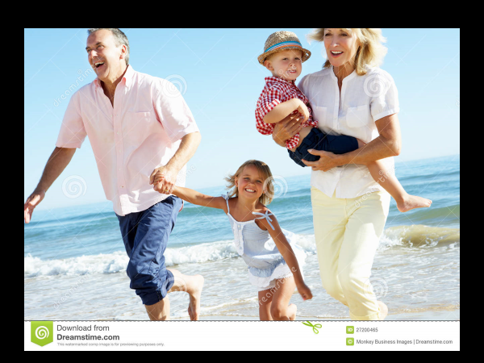
GRANDPARENT ALIENATION PART 6: COLMAN’S SUGGESTED GUIDING PRINCIPLES
Section B: Colman’s suggestions as to what it should mean to be a grandparent
Remember, you are not the parent, it is a different role that you now play.

Slide 41
GRANDPARENT ALIENATION PART 7: SOCIAL SCIENCE LITERATURE
Bastions of Stabilty

Slide 42
GRANDPARENT ALIENATION PART 7: SOCIAL SCIENCE LITERATURE
2. Relationships – crucial for a grandchild’s psychological health

Slide 43
SOCIAL SCIENCE LITERATURE
3. Grandparents bestow love and affection on grandchildren.

Slide 44
SOCIAL SCIENCE LITERATURE
4. Badmouthing = extreme emotional harm = child abuse.

Slide 45
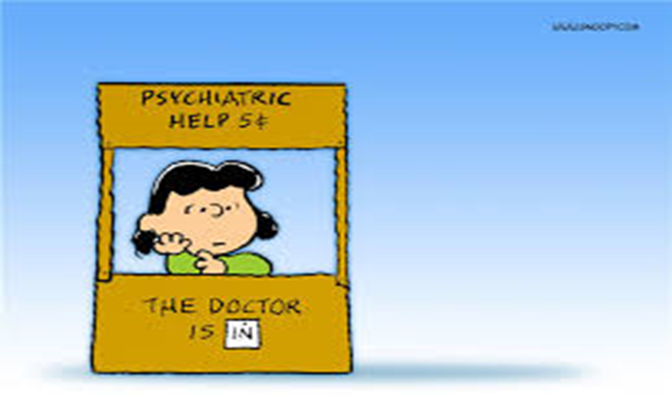
SOCIAL SCIENCE LITERATURE
5. Therapeutic Solutions

Slide 46
GRANDPARENT ALIENATION PART 7: SOCIAL SCIENCE LITERATURE
S. Beiner et al: Grandparents’ Rights: Psychological and Legal Perspectives
Philip Epstein agrees

Slide 47
GRANDPARENT ALIENATION PART 8: NON-JUDICIAL REMEDIES
Advocate For an End To Parental Alienation.

Slide 48
GRANDPARENT ALIENATION PART 8: NON-JUDICIAL REMEDIES
Avoid Litigation.

Slide 49
GRANDPARENT ALIENATION PART 8: NON-JUDICIAL REMEDIES
3. Engage In Family Therapy/Counseling.

Slide 50
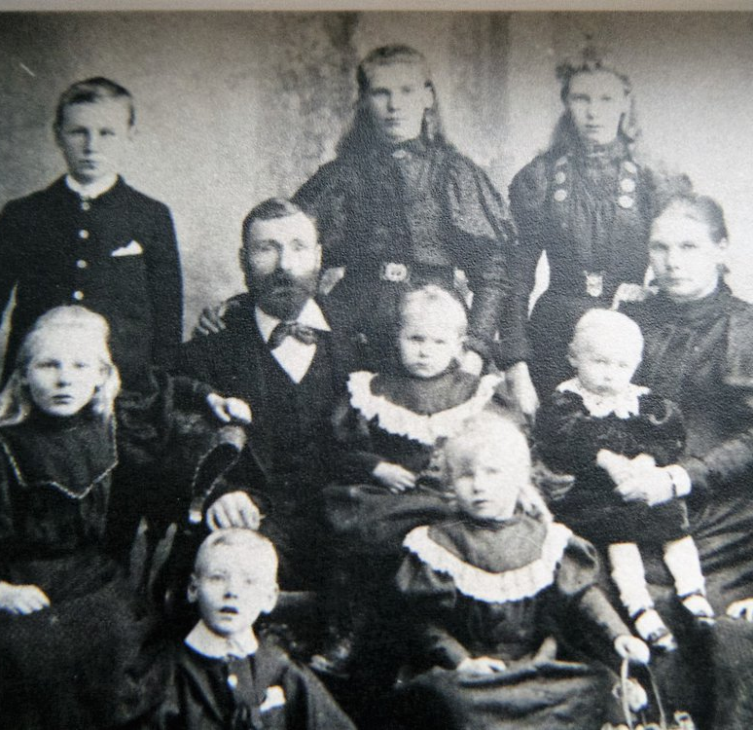
GRANDPARENT ALIENATION PART 9: SOME PARTING THOUGHTS, A STORY AND A SUMMING UP
Grandparents… history

Slide 51
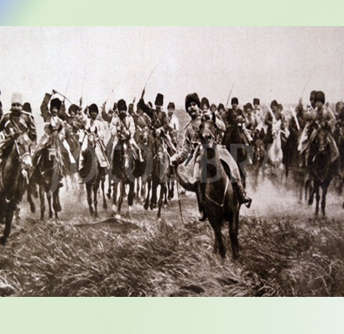
GRANDPARENT ALIENATION PART 9: SOME PARTING THOUGHTS, A STORY AND A SUMMING UP
An amazing story

Slide 52
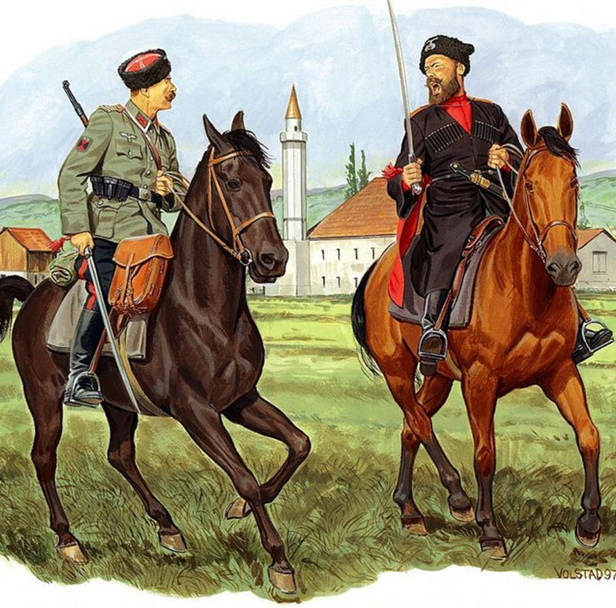
GRANDPARENT ALIENATION PART 9: SOME PARTING THOUGHTS, A STORY AND A SUMMING UP
An amazing story

Slide 53
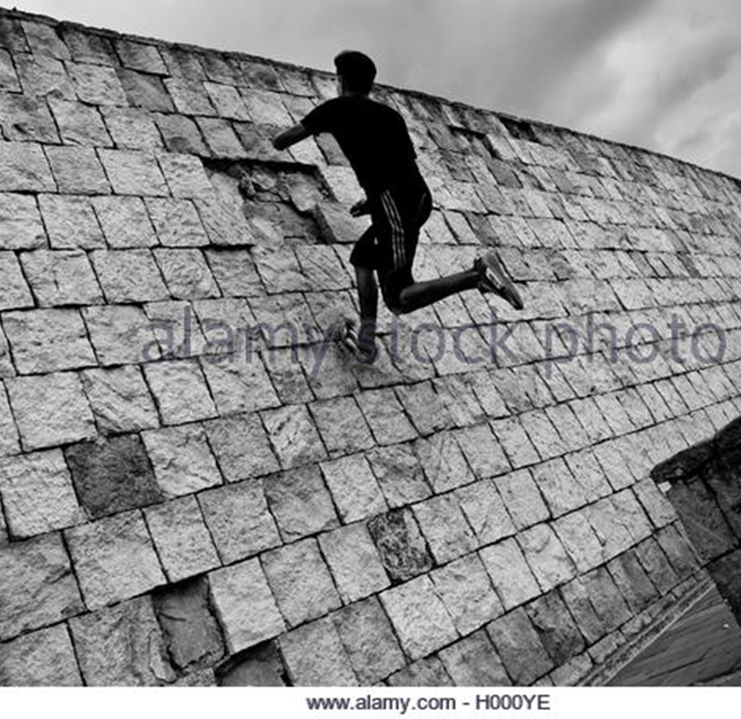
GRANDPARENT ALIENATION PART 9: SOME PARTING THOUGHTS, A STORY AND A SUMMING UP
An amazing story

Slide 54
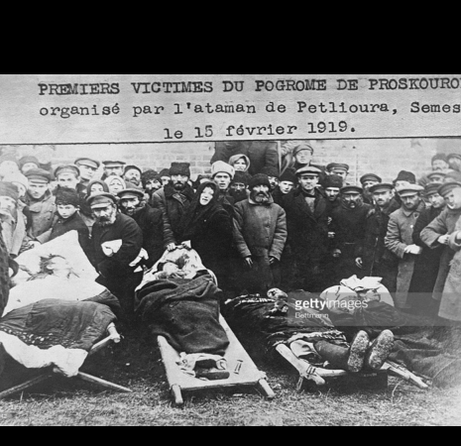
GRANDPARENT ALIENATION PART 9: SOME PARTING THOUGHTS, A STORY AND A SUMMING UP
An amazing story

Slide 55
GRANDPARENT ALIENATION PART 9: SOME PARTING THOUGHTS, A STORY AND A SUMMING UP
Colman’s personal reflections as a grandchild

Slide 56
GRANDPARENT ALIENATION PART 9: SOME PARTING THOUGHTS, A STORY AND A SUMMING UP

Slide 57
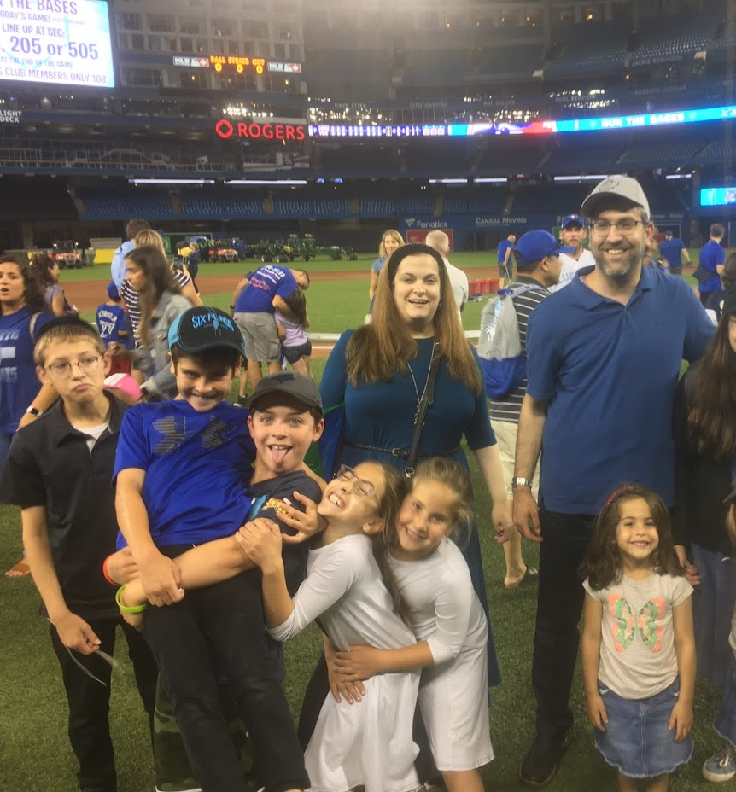
GRANDPARENT ALIENATION
PART 9: SOME PARTING THOUGHTS, A STORY AND A SUMMING UP

Slide 59
GRANDPARENT ALIENATION PART 9: SOME PARTING THOUGHTS, A STORY AND A SUMMING UP

Slide 60
GRANDPARENT ALIENATION PART 9: SOME PARTING THOUGHTS, A STORY AND A SUMMING UP
A call to action…

Slide 61
GRANDPARENT ALIENATION PART 10: SO WHAT HAVE WE LEARNED? LET’S SUM UP.
Terms
Three philosophies…. Hybrid
Statutory framework
Cases – Important Principles
Colman has strong objections.
Additional legal principles: anxiety and stress; destabilization; siblings

Slide 62
GRANDPARENT ALIENATION PART 10: SO WHAT HAVE WE LEARNED? LET’S SUM UP.
Guiding principles
Social Science
Non-Judicial Remedies
Personal observations, reflections and an amazing story
Thanks to all

Slide 63
GRANDPARENT ALIENATION PART 11: QUESTIONS AND DISCUSSION
Amanda of Alienated Grandparents Anonymous will comment first
Rob McNeillie will consolidate and pose the questions to Amanda and to GCC.

Slide 64
GRANDPARENT ALIENATION
PLEASE DONATE NOW TO:
North York Harvest Food Bank
https://northyorkharvest.com/gene-c-colman/

Slide 65
WATCH A REPLAY AND ACCESS COLMAN’S TALKING NOTES
Check out our Events page: https://www.complexfamilylaw.com/Events.shtml

Slide 66
THANKS AGAIN TO OUR PARTNERS
Alienated Grandparents Anonymous
Brayden Supervision Services
Canadian Association for Equality (CAFE)
Canadian Equal Parenting Council
Cangrands National Kinship Support
Equal Parenting for Children
Grandparents Without Access Hamilton
Lawyers for Shared Parenting
Real Women of Canada
Side by Side Supervised Access Services

Slide 67
AND A VERY SPECIAL THANKS TO OUR SPECIAL GUEST PANELIST
AMANDA

Slide 68
THANKS FOR ATTENDING Hope you enjoyed the presentation and found it useful and enlightening
GENE C. COLMAN FAMILY LAW CENTRE
For further information, call or write:
Tel: 416-635-9264
Gene C. Colman, Ext 101
Reception (Law Clerk, Kim Pitre), Ext. 100
Email: reception@complexfamilylaw.com
North York Harvest Food Bank
https://northyorkharvest.com/gene-c-colman/
Disclaimer: This powerpoint and the webinar do not constitute legal advice. Each situation is different. Consult your lawyer to determine if and how any of the ideas discussed here would affect your own situation.

